Slide 1
Two Dimensional Arrays
Fazeelat Mazhar

Slide 2
Book Chapter
“Assembly Language for x86 Processors”
Author “Kip R. Irvine”
6th Edition
Chapter 9
  Section 9.4

Slide 3
Two Dimensional Arrays (1/2)
Two-dimensional array is high-level abstraction of a one-dimensional array
Two methods to arrange rows and columns
  Row-Major Order
  Column-Major Order
x86 ISA has two operand types, base-index and base-index-displacement which are ideal to use with arrays

Slide 4
Two Dimensional Arrays (2/2)
 | 0 | 1 | 2
0 | 10 | 20 | 30
1 | 40 | 50 | 60
2 | 70 | 80 | 90
Logical arrangement
Row-Major Order
10 | 20 | 30 | 40 | 50 | 60 | 70 | 80 | 90
00 | 01 | 02 | 10 | 11 | 12 | 20 | 21 | 22
Column-Major Order
10 | 40 | 70 | 20 | 50 | 80 | 30 | 60 | 90
00 | 10 | 20 | 01 | 11 | 21 | 02 | 12 | 22

Slide 5
Base-Index Operands
Base-Index operand adds the values of two registers to produce an offset
These two registers are called Base and Index
In 32-bit mode, any extended general purpose register may be used as base and index
In 16-bit mode, base register must be either BX or BP and index must be SI or DI
Syntax is [Base+Index]

Slide 6
Accessing One-Dimensional Array
.data
arr DB 10h, 20h, 30h, 40h
.code
MOV BX, OFFSET arr
MOV SI, 2
MOV AL, [BX+SI] ;AL=
INC SI
MOV AL, [BX+SI] ;AL=

Slide 7
Accessing Two-Dimensional Array (1/2)
In row-major order
  Row-offset is held in base register
  Column-offset is held in index register
.data
arr DB 10h, 20h, 30h
r_size=($-arr); size of row
DB 40h, 50h, 60h
DB 70h, 80h, 90h

Slide 8
Accessing Two-Dimensional Array (2/2)
Suppose we want to locate value at row=1 and col=2
 | 0 | 1 | 2
0 | 10 | 20 | 30
1 | 40 | 50 | 60
2 | 70 | 80 | 90
.data
arr DB 10h, 20h, 30h
r_size=($-arr)
DB 40h, 50h, 60h
DB 70h, 80h, 90h
.code
r_ind=1
c_ind=2
MOV BX, OFFSET arr ;BX=100
ADD BX, r_size*r_ind;BX=100+3*1
MOV SI, c_ind ;SI=2
MOV AL, [BX+SI] ;AL=[103+2]
10 | 20 | 30 | 40 | 50 | 60 | 70 | 80 | 90
100 | 101 | 102 | 103 | 104 | 105 | 106 | 107 | 108
Address

Slide 9
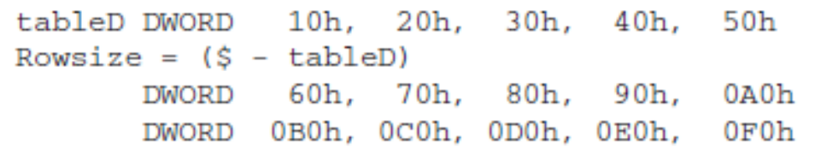
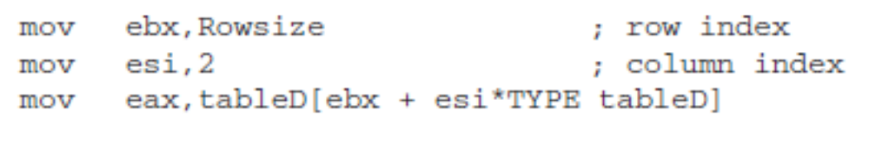
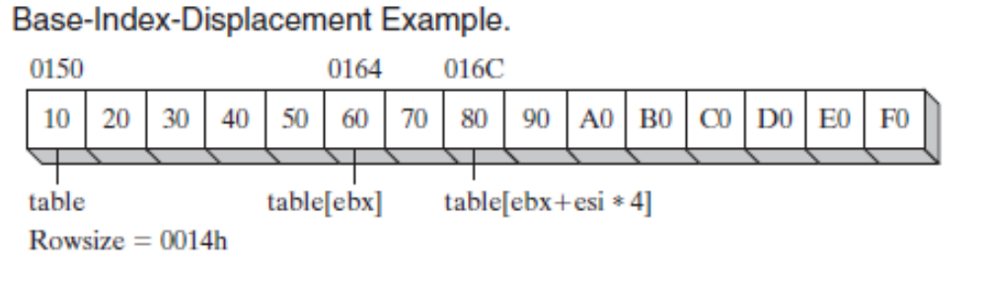
Base-Index-Displacement Operands(1/2)
[base + index + displacement]
displacement[base + index]
Rowsize is equal to 20 (14h).

